Slide 1

ADVENTUREWORKS SALES ANALYSIS

Slide 2

OVERVIEW
Introduction
Data Cleaning and Manipulation
Identifying Trends and Insights
Statistical Analysis
Recommendation

Slide 3

Introduction
Tools: The tools used for this analysis are Python, Power BI, DB Visualizer and DB Browser (SQLite)
Problem Definition: The main aim of the project is to understand the trends in the dataset in order to proffer solutions and recommendation to the business on how to increase the revenue and reduce losses. In order words, this analysis involves understanding the products with highest and lowest revenue as well as profit, the location performing best and which products are the highest sold in these regions.

Slide 4

DATABASE CONNECTION & data preparation
The dataset was connected to DB Browser (SQLITE) and relationships were created between the tables which was visualized in DB Visualizer to view the schema/pictorial representation of the relationships and better understand the data.
Further Analysis was carried out in Python by connecting to the SQLite database which includes deleting missing values, reclassifying data in groups for easy analysis, formatting the datatypes to fit the analysis.
After which was it imported to Power BI for visualization and conclusion.
Data Manipulation and cleaning was carried out on both Python and Power BI.

Slide 5

DATA CLEANING & MANIPULATION
Conditional formatting was applied, and new columns were created like Profit and Revenue, which was not available in the raw data.
Null values and duplicates were removed from the data. Inconsistent data types were manipulated either by grouping e.g ProductSize or formatting the data type e.g Date
Statistical analysis was also carried out to understand the correlation between the numerical variables and how they depend on each other.
Outliers was also checked using Boxplot to ensure we can rely on the data and be sure of no ambiguity in the results.

Slide 6
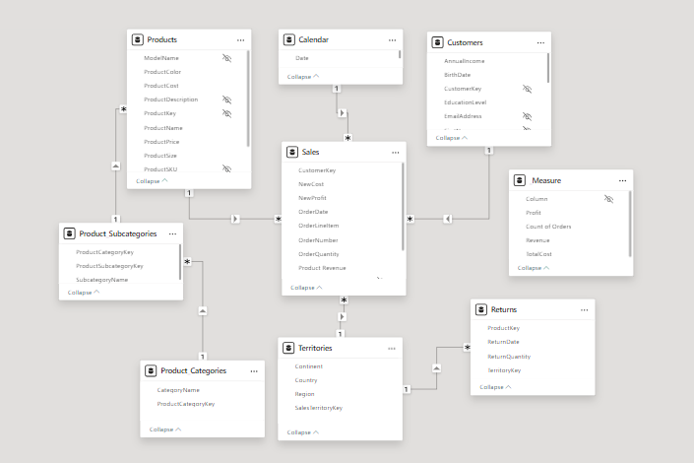
SCHEMA OF THE DATASET

Slide 7

Sales Analysis
KEY INSIGHTS:
The analysis based on revenue by year showed 2016 had the highest revenue with $9.3million, next to 2017 with $9.2million and the least being 2015 with $6.4million.
The best performing product is the Mountain-200 Black, 46 with over $1.2m in revenue and $571,633.74 in profit. Also, the mountain-200 brand is the top products in sales and profit. However, the least performing product is Racing Socks, L with revenue of $4,575.91 and a profit of $2,865.67. Although, in 2015 the top product brand was Road-150 Red with revenue of over $640k.
The product with the highest orders is Water Bottle- 30 oz with 3,983 orders and the least is Mountain 100 Silver- 48.
The best performing region is Australia with $7.4million in revenue , over $3m profit and 12,409 orders while the least performing region is Central with $3,143.06 revenue, $1,437.41 in profit and 20 orders.

Slide 8
Product Analysis
KEY INSIGHTS:
The highest sold color of products is Black with $7.9million revenue and the least color sold is White with $9,556 made as revenue
The most purchased Product category is Bikes, generating a revenue of $24million which is over 90% of the entire revenue and the least being Clothing with over $365,000 in revenue.
As shown in the report, Mountain- 200 brand are the top performing category of bikes with over $1million revenue each.
Analysing the products by region, North America has the highest purchase of Mountain-200 bikes with over $534k in revenue

Slide 9
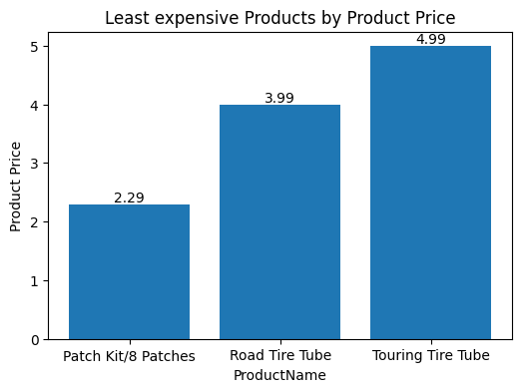
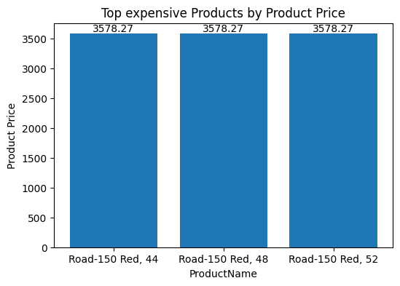
PRODUCT ANALYSIS
The least expensive products are patch kit, road tire tube and touring tire tube.
The top 3 expensive products are Road-150 Red, size 44, size 48 and size 52 with each costing $3578.27. These products were also the top products in 2015.

Slide 10

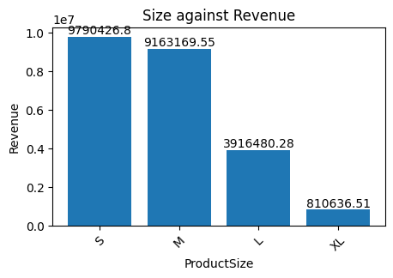
SALES ANALYSIS
The size with the highest revenue is Small with $9.7m in revenue, followed by Medium with $9.1m, then Large with $3.9m and the least is XL with $810k.

Slide 11
CUStOMER Analysis
KEY INSIGHTS:
The married spend more compared to singles (52% to 48%)
Based on Education Level, the highest average annual income is the Graduate Degree with $66k and the least being Partial High School with $40k.
Based on Occupation, Management roles earns the highest with an average of $92k, next to Professionals that earn $74k and the lowest is Manual jobs generating $16k.
With this we can say that the higher you earn, the higher the purchasing power which reflects in the order count.
Although, looking at spending habit, we have more customers not spending so much in the store compared to those that purchase a lot or buy the expensive products.

Slide 12
TERRITORY Analysis
KEY INSIGHTS:
Analysis based on Continent, as seen from product analysis, North America had the highest revenue of sales and in total, it generated $9.7m.
Based on Country, United Stated generated the most revenue with $7.9m and the least being Canada with $1.8m.
Based on Region, Australia has the highest sales with $7.4m in revenue
Looking at Profit, Australia made the highest profit with $3.1m and the least is Central with $1,437

Slide 13
Further Analysis
KEY INSIGHTS:
Comparing Education Level and income, Bachelors earn the highest and high earners accounts for a bulk of the revenue at $8.3k.
Analysis based on Homeowners showed that the higher you earn the higher the possibility of being a homeowner as compared to those that are low earners.
Across the 3 spending categories, those with no children spend more. Also, as number of children increases, the amount spent in the store reduces.

Slide 14
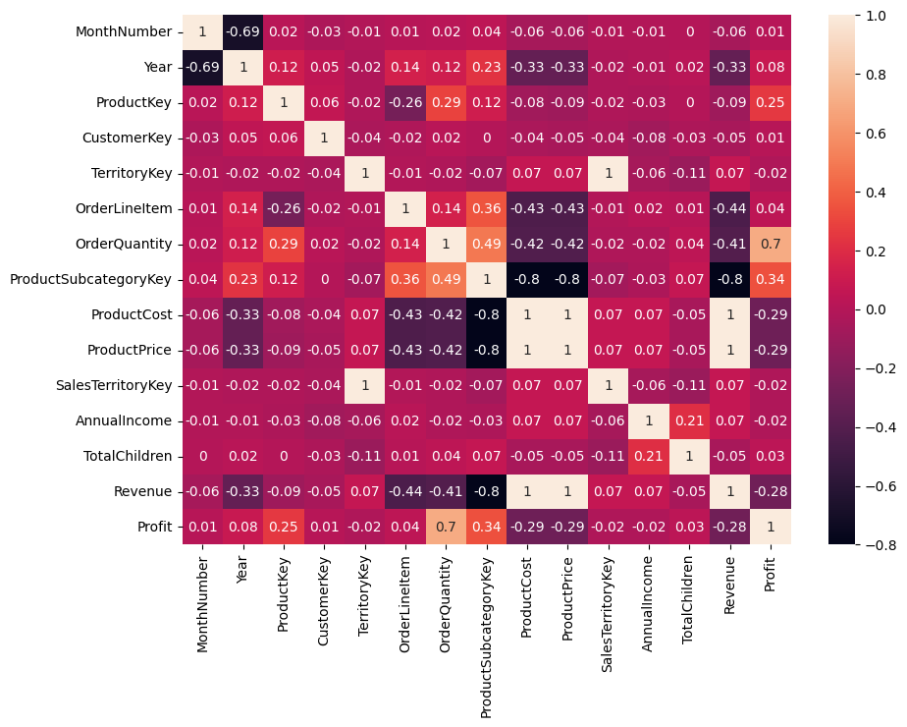
STATISTICAL Analysis
For the statistical analysis of the variables, Correlation was used to understand the relationship between the numerical data in the dataset.
There is a weak negative correlation between Order Quantity and Product Price showing a value of -0.42, this means as one variable increases, it might not impact the progressive decrease of the other.
It is also noticed that there is weak negative correlation between Product Cost and Profit showing a value of -0.29
Between Revenue and Profit, there is also a weak negative relationship with a value of -0.28.
Revenue and Product Price have a strong positive correlation relationship of 1, which means as the price of products increases, the revenue will also increase.

Slide 15
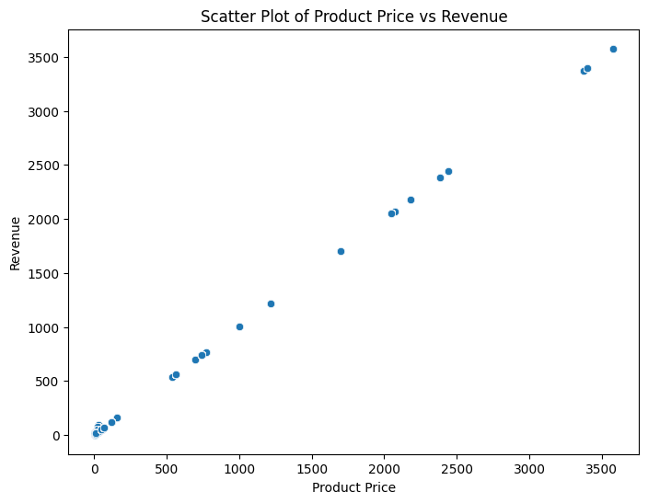
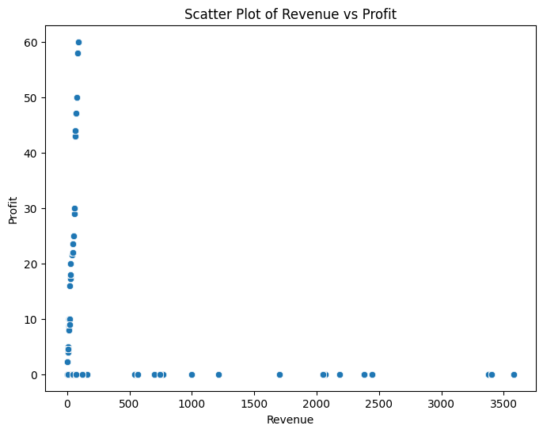
STATISTICAL Analysis
There is a strong positive relationship between product price and revenue. The Pearson correlation coefficient is 0.99 approx. 1 and the P-value is 0.0 which shows that the relationship is statistically significant and can be relied upon and is based on fact and not chance.
There is a weak negative relationship between profit and revenue. The Pearson correlation coefficient is -0.28 and the P-value: 0.0, which shows that the relationship is statistically significant and can be relied upon and is based on fact and not chance.

Slide 16
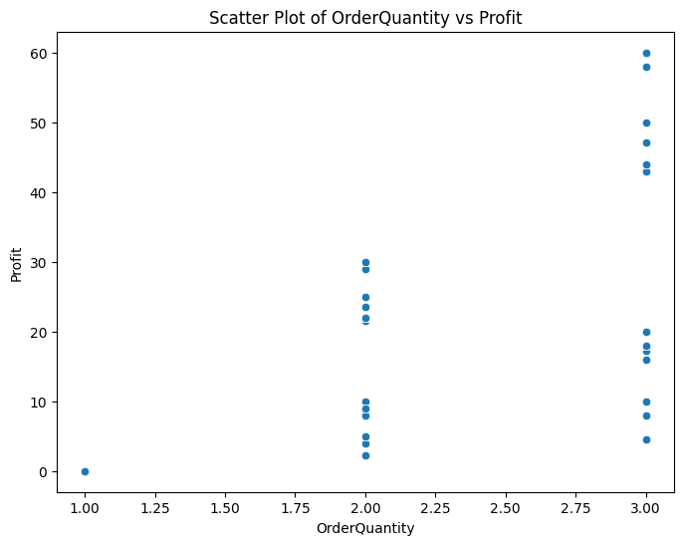
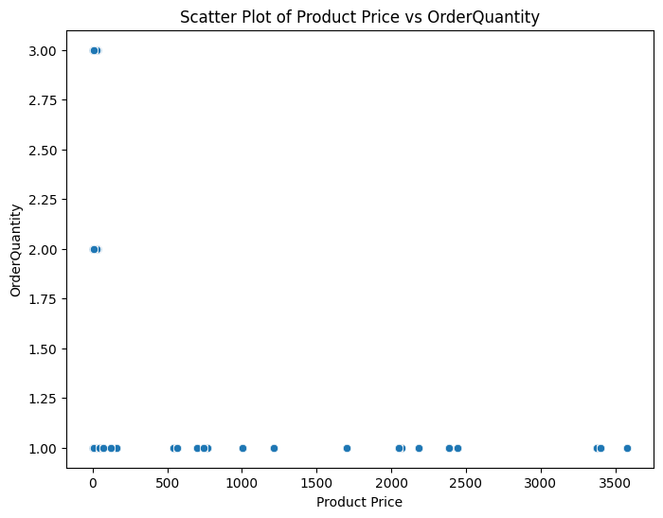
STATISTICAL Analysis
There is a strong positive relationship between profit and order quantity, this means that the higher quantity purchased, the more profit. The Pearson correlation coefficient is 0.70 and the P-value: 0.0, which shows that the relationship is statistically significant and can be relied upon and is based on fact and not chance.
There is a weak negative relationship between product price and order quantity. The Pearson correlation coefficient is -0.42 and the P-value: 0.0, which shows that the relationship is statistically significant and can be relied upon and is based on fact and not chance.

Slide 17

RECOMMENDATION
The analysis shows that no. of children impacts the spending power of customers, so we can target customers with no child or less children to increase the chances of sales.
The top 3 regions (Australia, Southwest, Northwest) should be focused on and ads targeting the right audience should be done even before the peak period, this will increase the chances of repurchase amongst customers.
Customers prefer the small and medium sizes, so production should focus more on these sizes to ensure maximum sales.
The same analogy applies to black-coloured shirts. More of the black-coloured products should be produced than white or other colours. This ensures that customers’ wants and needs are duly met.

Slide 18
RECOMMENDATION
Income directly affects purchasing power and analysis has shown that the type of education level a customer has will strongly influence their income, which will in turn influence their spending capacity. For products that are expensive like Road-150 Red, we can target those to the Graduate degree and Bachelors, and then the cheaper products like Patch kit, Road Tire Tube and Touring Tire Tube to the Partial High school certificate holder and High School certificate holder. This way, customers can easily get what’s within their budget, in return increasing sales probability.
The revenue from the least performing products, especially the Racing Socks brand products, is quite low, either discontinuing the sales of those products or increasing the publicity around those products. A buy-one-get-one free promo could be implemented during the peak season or add it at a discounted fee when a customer purchases any of the expensive products. Also upselling can be introduced for those

Slide 19
CONCLUSION
Sales is impacted by a lot of factors like Income, Education Level, order quantity, price, region and no of children, so proper profiling of each customer will help in targeting and understanding each customer’s needs and preferences which in turn will impact revenue positively.

Slide 20
THANK YOU
Salamah Alawiye
salamahalawiye@gmail.com
www.linkedin.com/in/salamahalawiye/

